Slide 1


Forecasting Store Sales
_______________________________________________________________________________________________________
Using Machine Learning to predict fluctuations in Ecuadorian grocery stores
GT Data & Analytics Bootcamp: March 7, 2023
_______________________________________________________________________________________________________

Slide 2





Forecasting Store Sales
_______________________________________________________________________________________________________
Using Machine Learning to predict fluctuations in Ecuadorian grocery stores
GT Data & Analytics Bootcamp: March 7, 2023
_______________________________________________________________________________________________________
Cathy Chang Tanner Horton Brandyn Jackson Jonathan Michel Victor Pang

Slide 3









The Challenge
We will be looking at Corporación Favorita, a large Ecuadorian-based grocery retailer.
We pulled the data from a Kaggle competition and we’ll be looking at the stores’ sales volume data from 2012-2017 and making predictions based on certain factors.
Notes:
Cathy

Slide 4
The Data
33 product types
350 holidays
Oil prices
Whether a product type was discounted/on promotion
Total Sales (in unit volume)
Notes:
Cathy
Ecuador is an oil-dependent country and it's economical health is highly vulnerable to shocks in oil prices

Slide 5
Assumptions & Early Predictions
Negative correlation between Oil Prices and Sales
Positive correlation between Holidays and Sales
Positive correlation between Discount Promotions and Sales
Notes:
Cathy

Slide 6
Data Cleaning
Filtered data to include January 2013 - July 2017
Removed NaN values
Removed columns for store type
Dropped duplicate holidays that resulted from government transfers
Notes:
Tanner

Slide 7
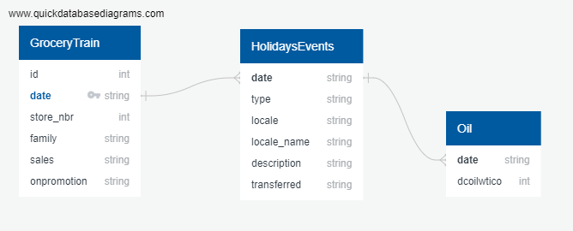
Entity Relationship Diagram
Transactions
id | int
date | datetime
store_nbr | int
family | string
sales | float
onpromotion | int
Holiday Events
date | datetime
type | string
locale | string
locale_name | string
description | string
transferred | string
Oil
date | datetime
dcoilwtico | int
Notes:
import matplotlib.pyplot as plt
import numpy as np
import pandas as pd, datetime, plotly seaborn sklearn sqlalchemy

Slide 8




Process
Multiple CSV’s
Cleaned & merged data before export to PgAdmin
Used to house data
Machine Learning
Notes:
Tanner

Slide 9
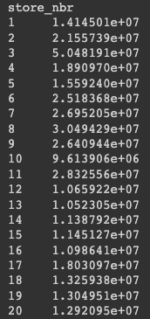
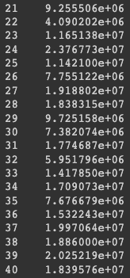
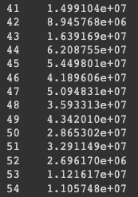
Total Individual Store Sales (Entire Timeframe)
Notes:
Tanner
Checking on time frame

Slide 10
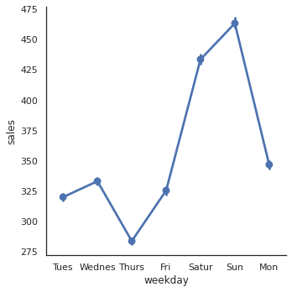
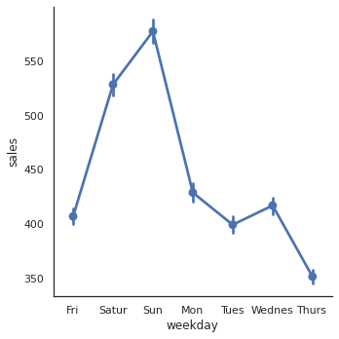
Average Weekday Sales
Entire Dataset (Jan. 2013 - July 2017)
Last Full Year Included (2016)
Notes:
Tanner

Slide 11
Holiday Impacts

Slide 12
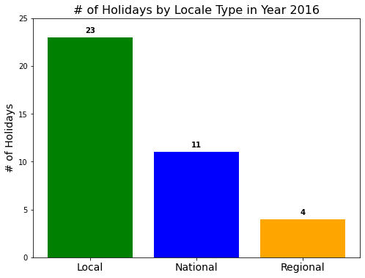
Impact of Holidays
Notes:
Victor

Slide 13
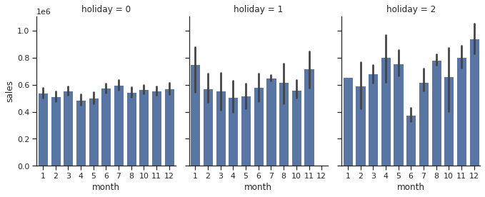
Effect of holidays on monthly sales
Non-Holidays
Local/Regional Holidays
National Holidays
Notes:
Victor
Filtered data to days that fall on National and non-National Holidays
Data rows were reduced from 3M to 433K
Applied ‘train_test_split()’ function to split the data into training and testing data
Created LinearRegression model
Fit the model
Used model to make predictions
Scored the predictions with mse (Mean Squared Error) and r2 (R-squared)
End results:
Mean Squared Error (MSE): 1592846.7794138745
R-squared (R2): 0.0004955063681998384

Slide 14
Oil Price Impacts

Slide 15
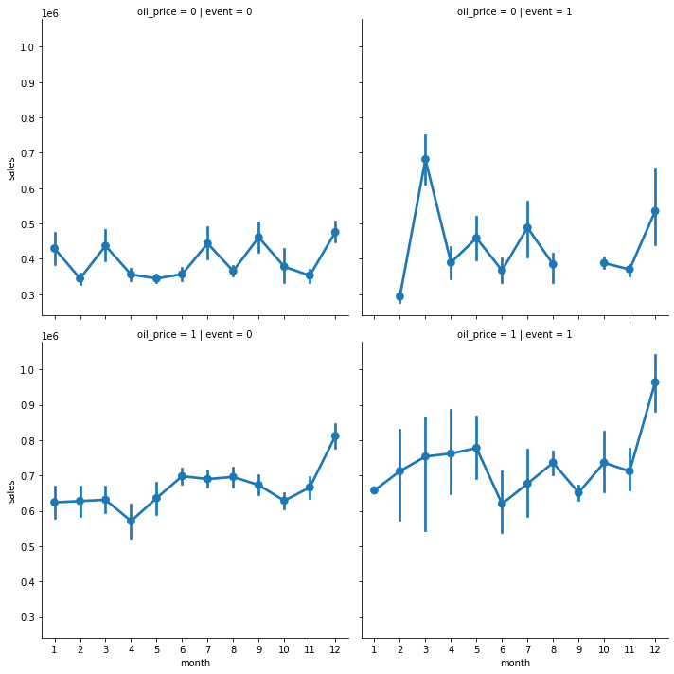
Oil < $90/barrel
& Non-holiday
Oil < $90/barrel
& holiday
Oil > $90/barrel
& Non-holiday
Oil > $90/barrel
& holiday
Notes:
In order to optimize these graphs oil prices were binned as above(1)/below(0) $90 per barrel and mark each day as either a holiday event(1) or non-holiday(0). The missing point from the top right graph, resulted from there never a holiday in September when the oil price was below $90 a barrel. We can assume that as oil prices increase, Ecuadorians are eating out less and spending more of their take home pay on groceries and essentials. This is especially true when steep oil price increases occur on or near national and regional holidays. The vertical lines represent confidence interval, or the set of values for each given month in which sales fall.

Slide 16
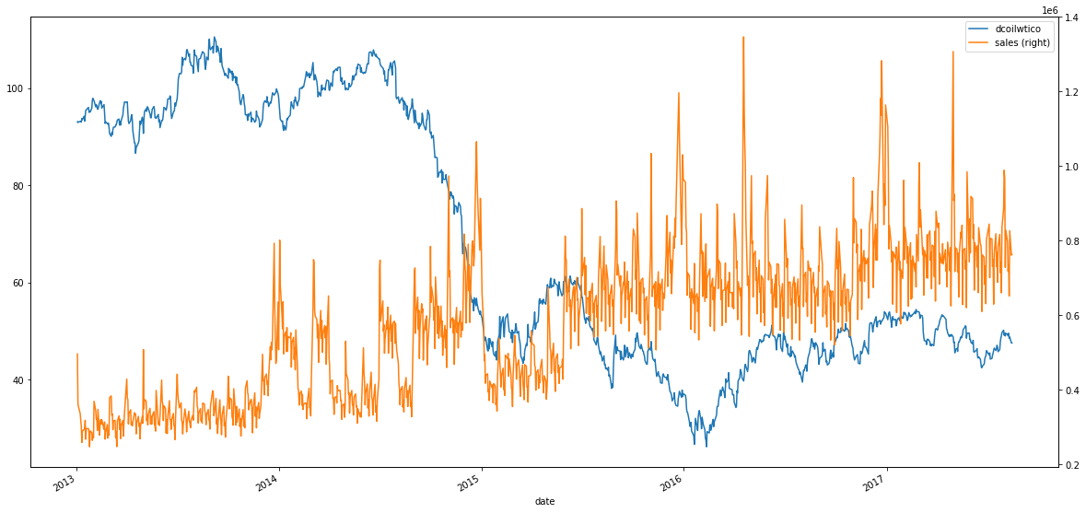
Impact of Oil
Notes:
Victor

Slide 17
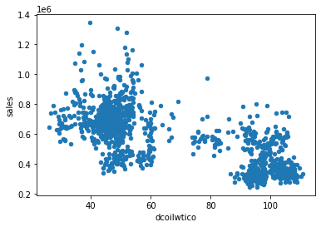
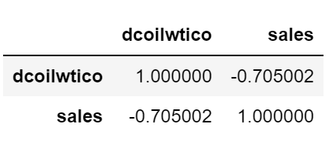
Impact of Oil Prices
Notes:
Victor

Slide 18
Promotional Activity

Slide 19
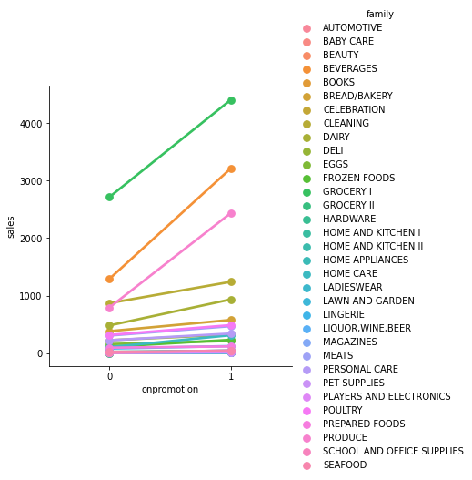
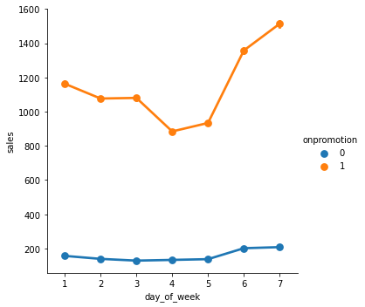
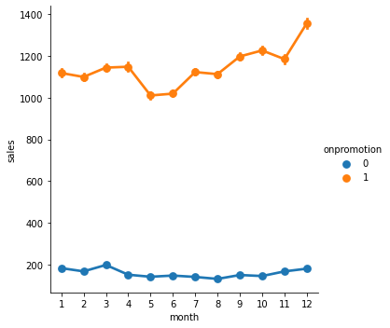
Impact of Discount Promotions - Weekends/2H
Promos seem to happen mostly over the weekends & within the 2nd half of the year, peaking in the December months
Notes:
Brandyn

Slide 20
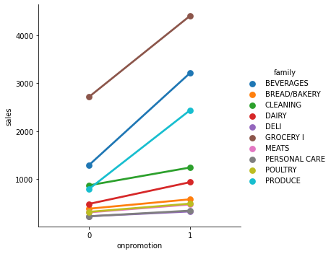
Top 10 Highest Promoted Products
As you can see, there are 3-5 products on promotion more than others:
Grocery I (Highest)
Beverages
Produce
Cleaning supplies
Dairy products
Notes:
Brandyn

Slide 21
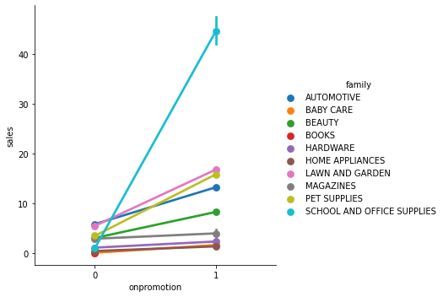
Top 10 Lowest Promoted Products
As you can see, there are 3-5 products on promotion more than others:
Home Appliances (Lowest)
Baby Care
Magazines
Beauty
Automotive
Notes:
Brandyn

Slide 22
Machine Learning Exploration

Slide 23

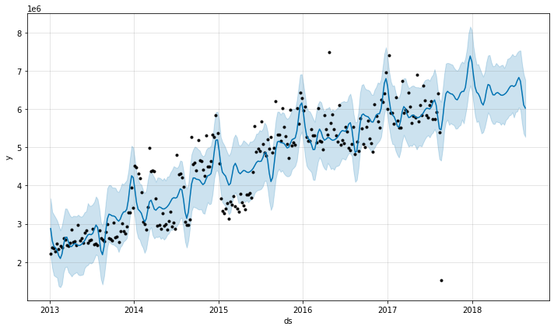
Time Series Analysis
Prophet - open source modelling tool by Facebook
Non-linear trends fit with seasonality, plus holiday effects
Rationale - Chosen due to adaptability of missing data & handles data outliers fairly well¹
RMSE: 592788.108415033
¹https://facebook.github.io/prophet/
Notes:
Jonathan

Slide 24
Conclusions
National Holidays drove higher monthly sales volume than Local/Regional Holidays, and non-Holiday events
Oil prices appear to have a negative correlation on sales volume
Promos seem to happen mostly over the weekends & within the 2nd half of the year, peaking in the December months
For future analysis: focus on binning, individual store performance, product type performance
Notes:
Jonathan

